Slide 1
Five Key Reasons to Belong to Your
Postal Customer Council
PCCAC Strategic Innovation and PCC Policy
Sub-Committee
January 18, 2022
Notes:
Kat: Welcome the PCCAC Strategic Innovation and PCC Policy Subcommittee Café.

Slide 2
Housekeeping
Please utilize the chat box to ask questions and voice any comments or concerns.
PPT presentation along with the recording will be posted on PostalPro.
Please note: All phones will be muted due to the large volume of participants that we have on today’s call.
Notes:
Kat: Standard housekeeping verbiage

Slide 3
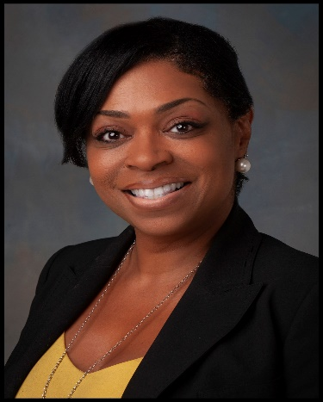
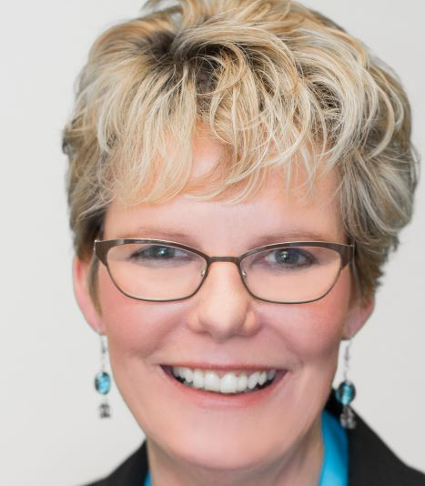
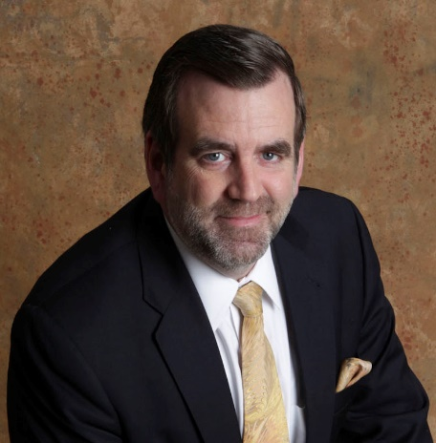
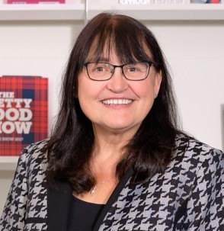
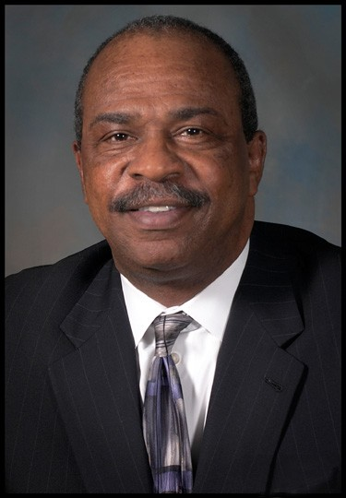
Presenters
Katrina Raysor
Judy Antisdel
Mark Fallon
Suzi Oswald
Lewis Johnson
Get Connected and Grow!
Notes:
Kat: Our presenters today are:
Myself, Katrina Raysor, Industry Engagement & Outreach Specialist at United States Postal Service. And I serve as the Postal Co-Chair of the PCCAC Strategic Innovation and PCC Policy Subcommittee
Judy Antisdel, President of AT Direct, and Industry Chairperson of the Greater Baltimore Postal Customer Council
Mark Fallon, President of The Berkshire Company, and Industry Co-Chair of the PCCAC Strategic Innovation and PCC Policy
Suzi Oswald, Postal Specialist at SeaChange Print Innovations, and Industry Co-Chair of the PCCAC Membership Growth and Recruitment Subcommittee
Lewis Johnson, PCC Program Manager at United States Postal Service, and Postal Co-Chair of the PCCAC Membership Growth and Recruitment Subcommittee
Now I will turn it over to Mark and Judy for the first part of our webinar.

Slide 4
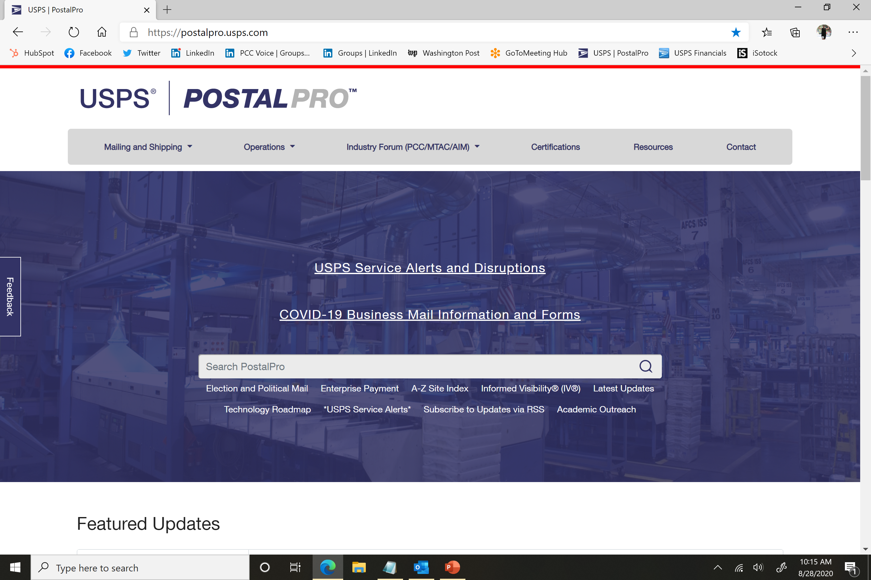
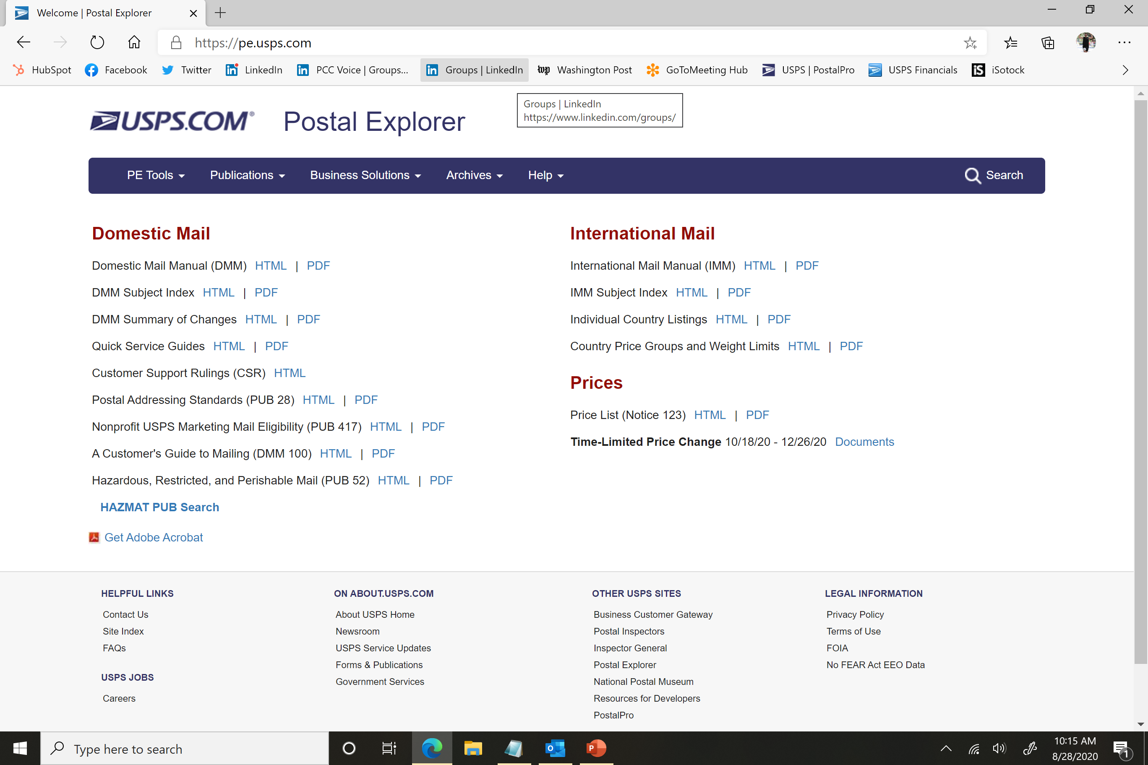
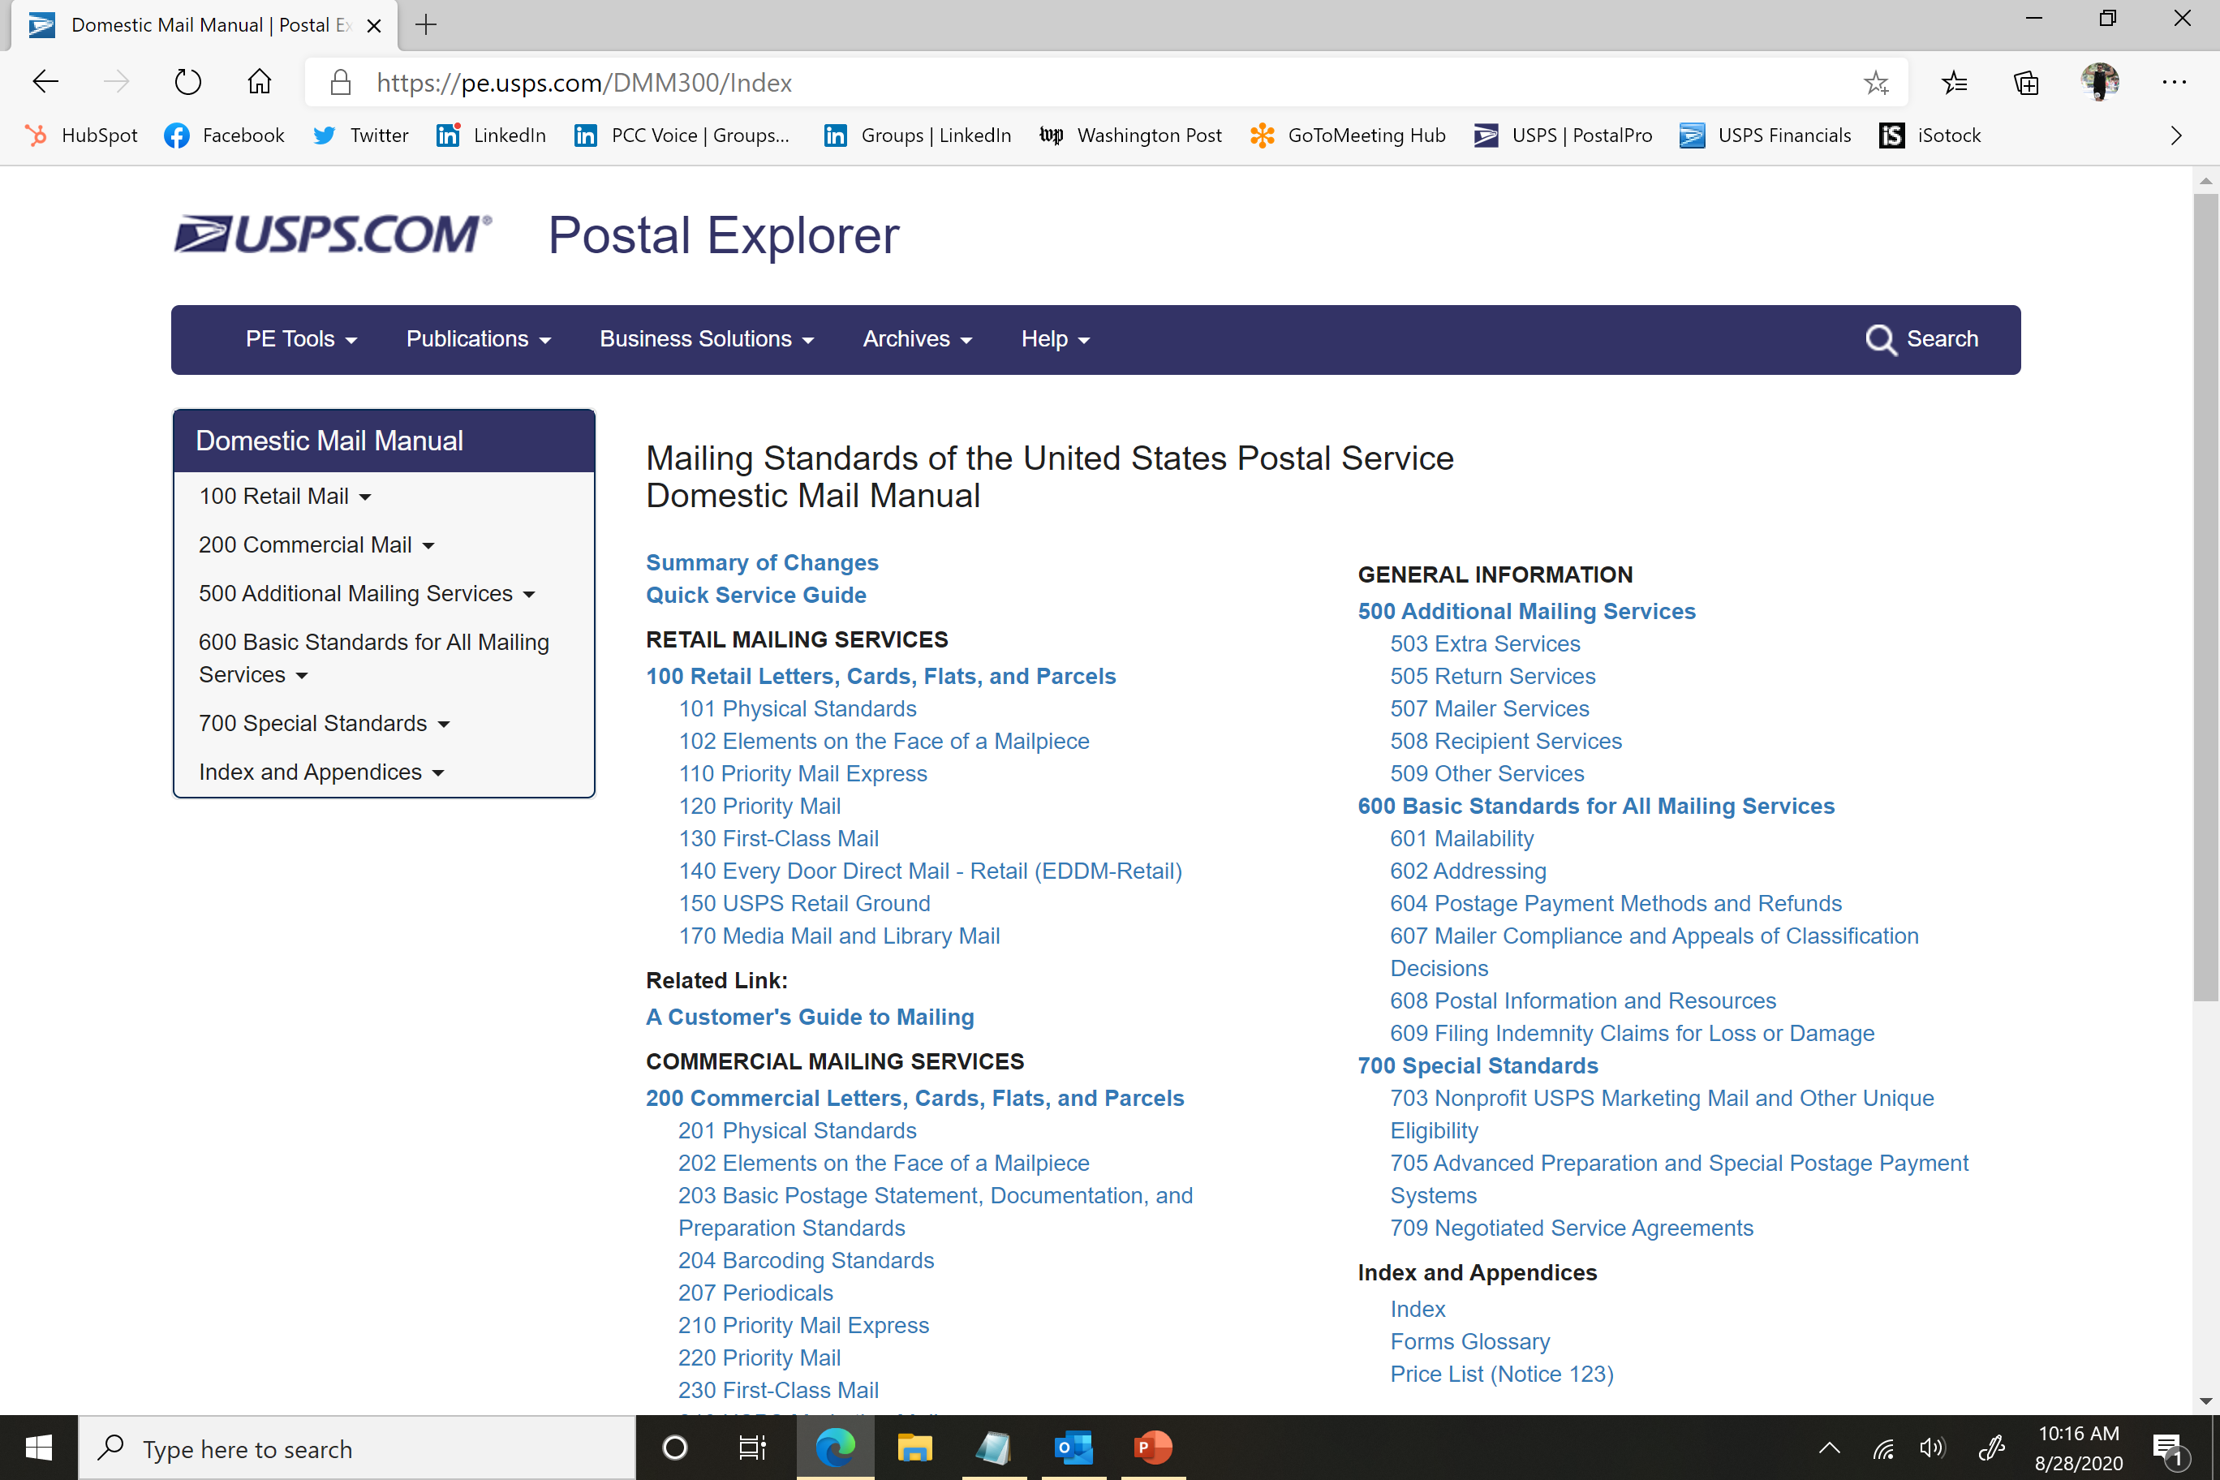
#5 – Postal Education
Get Connected and Grow!
Notes:
Judy – Thanks, Kat. Then Judy says something interesting about postal education. She will probably get interrupted by Mark at some point.

Slide 5
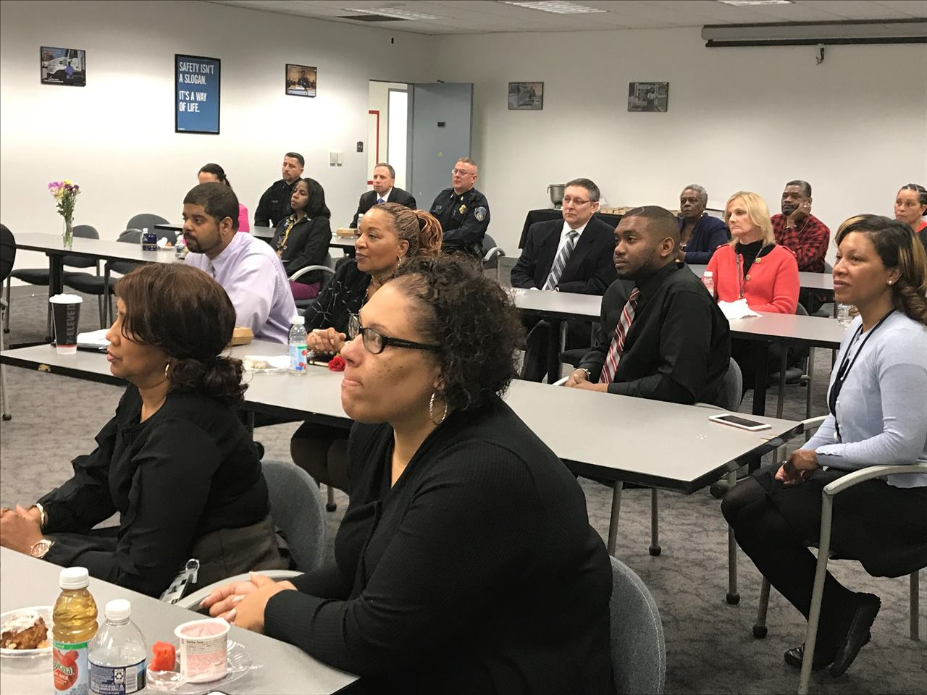
#4 – Industry Education
Get Connected and Grow!
Notes:
Mark - says something interesting about Industry education. She will probably get interrupted by Judy at some point.

Slide 6
#3– Postal Networking
Get Connected and Grow!
Notes:
Judy starts, Mark interrupts

Slide 7
#2 – Industry Networking
Get Connected and Grow!
Notes:
Mark starts, Judy interrupts

Slide 8
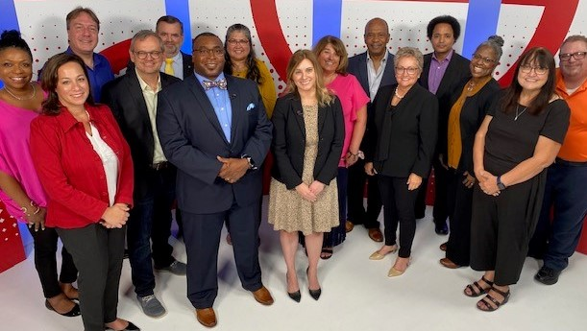
#1 – Leadership Through Service
Get Connected and Grow!
Notes:
Judy, Judy, Judy

Slide 9
Questions
Get Connected and Grow!
Notes:
Mark: Now I would like to invite my fellow PCCAC Board Members – Suzi Oswald and Lewis Johnson to join us. And we’ll answer questions that people have posted, as well as any new questions that come up.
We take turns making up answers.

Slide 10
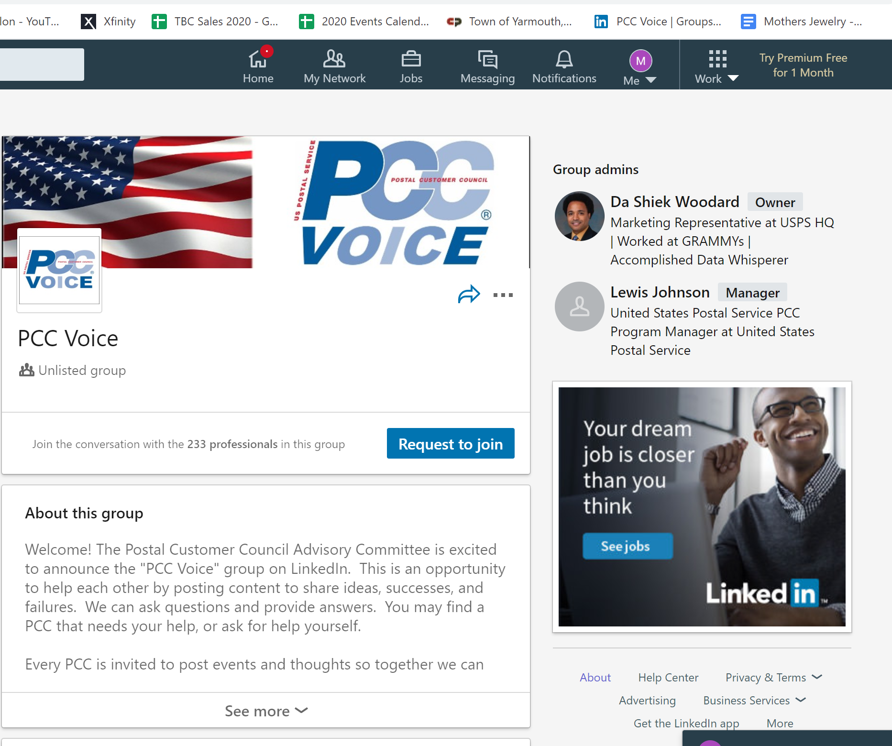
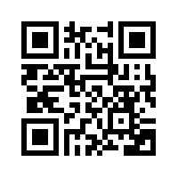
PCC Voice! On LinkedIn
How to Join:
Step 1: Sign up for a LinkedIn account:
https://www.linkedin.com/signup/cold-join?trk=guest_homepage-basic_directory
Step 2: Use this link to join the group:
https://www.linkedin.com/groups/8303549
For questions, contact PCC@USPS.gov
Get Connected and Grow!
Notes:
Mark: A reminder to join PCC Voice! On LinkedIn

Slide 11
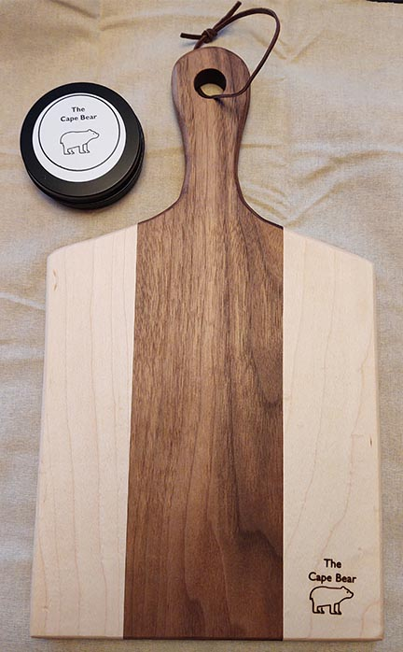
PCC Voice! Winter Challenge The Board Challenge
When: January 18 – March 18, 2022
What: Post a photo or screenshot (for virtual meetings) of your next PCC Board Meeting on PCC Voice!
Winner: All participating PCCs will be entered into a raffle
The Prize: A board that won’t leave your board bored!
Notes:
Mark – New contest!!!!!!!!!!!!!!!!!!!!!!!!!!!!!!!!!!!!!!

Slide 12
Thanks for attending!
Get Connected and Grow!
Notes:
Thank you all. And we look forward to seeing you at a future PCCAC event, the NPF in Phoenix this May, and of course, on PCC Voice!
Good bye!

